Slide 1
THIRTEENTH SUNDAY
AFTER PENTECOST
September 8, 2019
10:45 AM

Slide 2
GATHERING
The Holy Spirit calls us together as the people
of God.

Slide 3
PRELUDE

Slide 4
WELCOME AND ANNOUNCEMENTS
Safe Harbor Video

Slide 5


Slide 6
GATHERING SONG
“Join the Journey”

Slide 7
Come join the journey of Jesus today;
Love is the light that will show us the way.
And like the trees, bearing good fruit,
we will bring forth Jesus' love.

Slide 8
Come join the journey of Jesus today;
Joy in the spirit will brighten our way.
And like the trees, bearing good fruit,
we will bring forth Jesus' joy.

Slide 9
Come join the journey of Jesus today;
Peace is the promise for us to proclaim.

Slide 10
And like the trees, bearing good fruit,
we will bring forth Jesus' peace.

Slide 11
Come join the journey of Jesus today;
Love is the light that will show us the way.

Slide 12
And like the trees, bearing good fruit,
we will bring forth Jesus' love.
We will bring forth Jesus' love.

Slide 13
Confession of sins and hearing the good news (please stand)
All may make the sign of the cross, the sign marked at baptism

Slide 14
In the name of the Father, and of the ☩ Son, and of the Holy Spirit.
Amen

Slide 15
If we have died with Christ, we will also live with Christ.
Let us confess our sin to the one who is faithful.
Silence is kept for reflection.

Slide 16
God our helper,
we confess the many ways
we have failed to live as your disciples.
We have not finished what we began.

Slide 17
We have feasted with friends but ignored strangers.
We have been captivated by our possessions.
Lift our burdens, gracious God.

Slide 18
Refresh our hearts and forgive our sin.
Raise us to the new life you have chosen for us
in Jesus Christ, our Savior and Lord.
Amen

Slide 19
There is rejoicing in heaven when sinners repent.
Put your trust in these promises: God will never leave you or forsake you.

Slide 20
You who were lost have been found.
For the sake of ☩ Jesus Christ, your sins are forgiven.
Thanks be to God!

Slide 21
Song OF PRAISE
“My Life Is in You Lord”

Slide 22
My life is in You, Lord.
My strength is in You, Lord.
My hope is in You, Lord,
In You, It’s in You.

Slide 23
My life is in You, Lord.
My strength is in You, Lord.
My hope is in You, Lord,
In You, It’s in You.

Slide 24
I will praise You with all of my life.
I will praise you with all of my strength.
With all of my life,
with all of my strength.

Slide 25
All of my hope is in You.
My life is in You, Lord.
My strength is in You, Lord.
My hope is in You, Lord,

Slide 26
In You, It’s in You.
My life is in You, Lord.
My strength is in You, Lord.
My hope is in You, Lord,
In You, It’s in You.

Slide 27
I will praise You with all of my life.
I will praise you with all of my strength.
With all of my life, with all of my strength.
All of my hope is in You.

Slide 28
My life is in You, Lord.
My strength is in You, Lord.
My hope is in You, Lord,
In You, It’s in You.

Slide 29
My life is in You, Lord.
My strength is in You, Lord.
My hope is in You, Lord,
In You, It’s in You. In You.

Slide 30
PRAYER
Direct us, O Lord God, in all we do, with your continual help, that in all our works, begun, continued, and ended in you, we may glorify your holy name;

Slide 31
and finally, by your mercy, bring us to everlasting life, through Jesus Christ, our Savior and Lord. Amen (please be seated)

Slide 32
BACKPACK BLESSING /
NOISY OFFERING

Slide 33
WORD
God speaks to us in Scripture reading, preaching, and song.

Slide 34
FIRST READING
Deuteronomy 30:15-20 Pew Bible OT, p. 206

Slide 35
See, I have set before you today life and prosperity, death and adversity. If you obey the commandments of the Lord your God that I am commanding you today,

Slide 36
by loving the Lord your God, walking in his ways, and observing his commandments, decrees, and ordinances,

Slide 37
then you shall live and become numerous, and the Lord your God will bless you in the land that you are entering to possess.

Slide 38
But if your heart turns away and you do not hear, but are led astray to bow down to other gods and serve them, I declare to you today that you shall perish;

Slide 39
you shall not live long in the land that you are crossing the Jordan to enter and possess.

Slide 40
I call heaven and earth to witness against you today that I have set before you life and death, blessings and curses.

Slide 41
Choose life so that you and your descendants may live, loving the Lord your God, obeying him, and holding fast to him; for that means life to you and length of days,

Slide 42
so that you may live in the land that the Lord swore to give to your ancestors, to Abraham, to Isaac, and to Jacob.

Slide 43
Word of God, Word of life.
Thanks be to God.

Slide 44
PSALM
Psalm 1
(read responsively)

Slide 45
Happy are they who have not walked in the counsel of the wicked, nor lingered in the way of sinners, nor sat in the seats of the scornful!

Slide 46
Their delight is in the law of the Lord, and they meditate on God’s teaching day and night.

Slide 47
They are like trees planted by streams of water, bearing fruit in due season, with leaves that do not wither; everything they do shall prosper.

Slide 48
It is not so with the wicked;
they are like chaff which the wind blows away.

Slide 49
Therefore the wicked shall not stand upright when judgment comes, nor the sinner in the council of the righteous.

Slide 50
For the Lord knows the way of the righteous,
but the way of the wicked shall be destroyed.

Slide 51
(please stand)
ALLELUIA
“Hallelujah, Hear Our Praises”

Slide 52
From the mountains to the valley Hear our praises rise to You.
From the heavens to the nations, Hear the singing fill the air.

Slide 53
Hallelujah. Hallelujah. Hallelujah. Hallelujah.
Hallelujah. Hallelujah. Hallelujah. Hallelujah.

Slide 54
From the mountains to the valley Hear our praises rise to You.
From the heavens to the nations, Hear the singing fill the air.

Slide 55
The holy gospel
according to Luke.
Glory to you, O Lord.

Slide 56
Gospel
Luke 14:25-33 Pew Bible NT, p. 79

Slide 57
Now large crowds were travelling with him; and he turned and said to them,

Slide 58
‘Whoever comes to me and does not hate father and mother, wife and children, brothers and sisters, yes, and even life itself, cannot be my disciple.

Slide 59
Whoever does not carry the cross and follow me cannot be my disciple. For which of you, intending to build a tower, does not first sit down and estimate the cost, to see whether he has enough to complete it?

Slide 60
Otherwise, when he has laid a foundation and is not able to finish, all who see it will begin to ridicule him, saying,

Slide 61
“This fellow began to build and was not able to finish.” Or what king, going out to wage war against another king,

Slide 62
will not sit down first and consider whether he is able with ten thousand to oppose the one who comes against him with twenty thousand?

Slide 63
If he cannot, then, while the other is still far away, he sends a delegation and asks for the terms of peace. So therefore, none of you can become my disciple if you do not give up all your possessions.

Slide 64
The gospel of the Lord.
Praise to you, O Christ.
(please be seated)

Slide 65
Sermon
Pastor Erin

Slide 66
SONG of the dAY “Take My Life”
(please stand on last verse)

Slide 67
Take my life and let it be Consecrated Lord to Thee.
Take my moments and my days, Let them flow in ceaseless praise.

Slide 68
Take my hands and let them move,
At the impulse of Thy love.
Take my feet and let them be Swift and beautiful for Thee.

Slide 69
Take my voice and let me sing, Always only for my King.
Take my lips and let them be Filled with messages from Thee.

Slide 70
Take my silver and my gold. Not a mite would I withhold.
Take my intellect and use Every power as You choose.

Slide 71
Here am I,
all of me.
Take my life,
it's all for Thee

Slide 72
(Please stand)
Take my will and make it Thine It shall be no longer mine.
Take my heart it is Thine own, It shall be Thy royal throne.

Slide 73
Take my love, my Lord,
I pour At your feet its treasure store.
Take myself and I will be Ever only all for thee.

Slide 74
Take myself and I will be Ever only all for Thee.
Take myself and I will be Ever only all for Thee.

Slide 75
APOSTLES’ CREED
With the whole church, let us confess our faith.

Slide 76
I believe in God, the Father almighty, creator of heaven and earth.

Slide 77
I believe in Jesus Christ, God's only Son, our Lord,
who was conceived by the Holy Spirit, born of the virgin Mary, suffered under Pontius Pilate,

Slide 78
was crucified, died, and was buried; he descended to the dead. On the third day he rose again; he ascended into heaven,

Slide 79
he is seated at the right hand of the Father, and he will come to judge the living and the dead.

Slide 80
I believe in the Holy Spirit, the holy catholic church,
the communion of saints, the forgiveness of sins,

Slide 81
the resurrection of the body, and the life everlasting.
Amen

Slide 82
Offering
(please be seated)

Slide 83
We glorify God in our giving. Our offering is an act of worship that makes the ministries of this congregation possible. We encourage everyone to give. If you are visiting with us today, please do not feel obligated to participate in this portion of worship. If you would like to use your smart phone to give online, see the card with our QR code in the pew racks.

Slide 84
The children are welcome to come forward and place their offerings in the “For Children Everywhere” box.

Slide 85
OFFERING SONG
“I Give You My Heart”

Slide 86
This is my desire, to honor You.
Lord, with all my heart I worship You.
All I have within me,
I give You praise.
All that I adore is in You.

Slide 87
Lord, I give You my heart.
I give You my soul.
I live for You alone.

Slide 88
Every breath that I take,
every moment I’m awake,
Lord, have Your way in me.

Slide 89
This is my desire,
to honor You.
Lord, with all my heart I worship You.
All I have within me,
I give You praise.
All that I adore is in You.

Slide 90
Lord, I give You my heart.
I give You my soul.
I live for You alone.
Every breath that I take,
every moment I’m awake,
Lord, have Your way in me.

Slide 91
Lord, I give You my heart.
I give You my soul.
I live for You alone.
Every breath that I take,
every moment I’m awake,
Lord, have Your way in me.

Slide 92
Offering Prayer
(please stand)

Slide 93
God our provider, we bring nothing into this world and we can take nothing out of it. Accept the gifts you have first given us, which we bring to your table, and with them the offering of our lives.

Slide 94
Nourish us now with the life that really is life, revealed to us in Jesus Christ, our Savior and Lord. Amen

Slide 95
THE LORD’S SUPPER
God feeds us with the presence of Jesus Christ.
God feeds us with the presence of Jesus Christ.

Slide 96
GREAT THANKSGIVING
The Lord be with you.
And also with you.

Slide 97
Lift up your hearts.
We lift them to the Lord.

Slide 98
Let us give thanks to the Lord our God.
It is right to give our thanks and praise.

Slide 99
WORDS OF INSTITUTION
Lord's Prayer
We pray in confidence in the words Jesus gave us:

Slide 100
Our Father in heaven, hallowed be your name, your kingdom come, your will be done, on earth as it is in heaven.

Slide 101
Give us today our daily bread. Forgive us our sins as we forgive those who sin against us.

Slide 102
Save us from the time of trial and deliver us from evil. For the kingdom, the power, and the glory are yours, now and forever. Amen.

Slide 103
Invitation to Communion
(please be seated)

Slide 104
All who are baptized and trust Christ’s word are welcome to the Lord’s table.
Please come forward as directed by the ushers. Grape juice and gluten free wafers are available; please indicate to the server by raising your hand.

Slide 105
COMMUNION SONG
“Amazing Grace,
My Chains Are Gone”

Slide 106
Amazing Grace,
how sweet the sound.
That saved a wretch like me.
I once was lost but now am found.
Was blind but now I see.

Slide 107
Twas Grace that taught my heart to fear
And Grace my fears relieved.
How precious did that grace appear,
The hour I first believed.

Slide 108
My chains are gone,
I've been set free.
My God, my Savior has ransomed me.

Slide 109
And like a flood his mercy reigns;
Unending love, amazing grace.

Slide 110
The Lord has promised good to me.
His word my hope secures;
He will my shield and portion be,
As long as life endures.

Slide 111
My chains are gone,
I've been set free.
My God, my Savior has ransomed me.

Slide 112
And like a flood his mercy reigns;
Unending love, amazing grace.

Slide 113
The earth shall soon dissolve like snow.
The sun forbear to shine.

Slide 114
But God who called me hear below,
Will be forever mine.
Will be forever mine.
Will be forever mine.

Slide 115
BLESSING & Prayer
after Communion
(please stand)

Slide 116
The body and blood of our Lord Jesus Christ strengthen you and keep you in his grace.
Amen.

Slide 117
Living God, you have greeted us in our brokenness and nourished us with the body of Christ, broken for us.

Slide 118
Risen to new life with you, send us now to bear your healing love into the wounded world, in the name of our risen Savior and Lord. Amen.

Slide 119
SENDING
God blesses us and sends us in mission to the world.

Slide 120
BENEDICTION

Slide 121
The God of hope fill you with all joy and peace in believing, so that you may abound in hope by the power of the Holy Spirit. Amen

Slide 122
SENDING SONG
“Holy Is the Lord”

Slide 123
We stand and lift up our hands,
For the joy of the Lord is our strength.
We bow down and worship Him now.

Slide 124
How great,
how awesome is He.
And together we sing,
Everyone sing.

Slide 125
Holy is the Lord,
God Almighty,
The earth is filled with His glory.
Holy is the Lord,
God Almighty,

Slide 126
The earth is filled with His glory.
The earth is filled with His glory.

Slide 127
We stand and lift up our hands,
For the joy of the Lord is our strength.
We bow down and worship Him now.

Slide 128
How great,
how awesome is He.
And together we sing,
Everyone sing.

Slide 129
Holy is the Lord,
God Almighty,
The earth is filled with His glory.
Holy is the Lord, God Almighty,

Slide 130
The earth is filled with His glory.
The earth is filled with His glory.

Slide 131
It is rising up all around;
It’s the anthem of the Lord’s renown.
It is rising up all around;
It’s the anthem of the Lord’s renown.

Slide 132
And together we sing,
Everyone sing.
Holy is the Lord,
God Almighty,
The earth is filled with His glory.

Slide 133
Holy is the Lord,
God Almighty,
The earth is filled with His glory.
The earth is filled with His glory.

Slide 134
SENDING WORDS
Go in peace
Live in love as Christ loved us.
Thanks be to God!

Slide 135
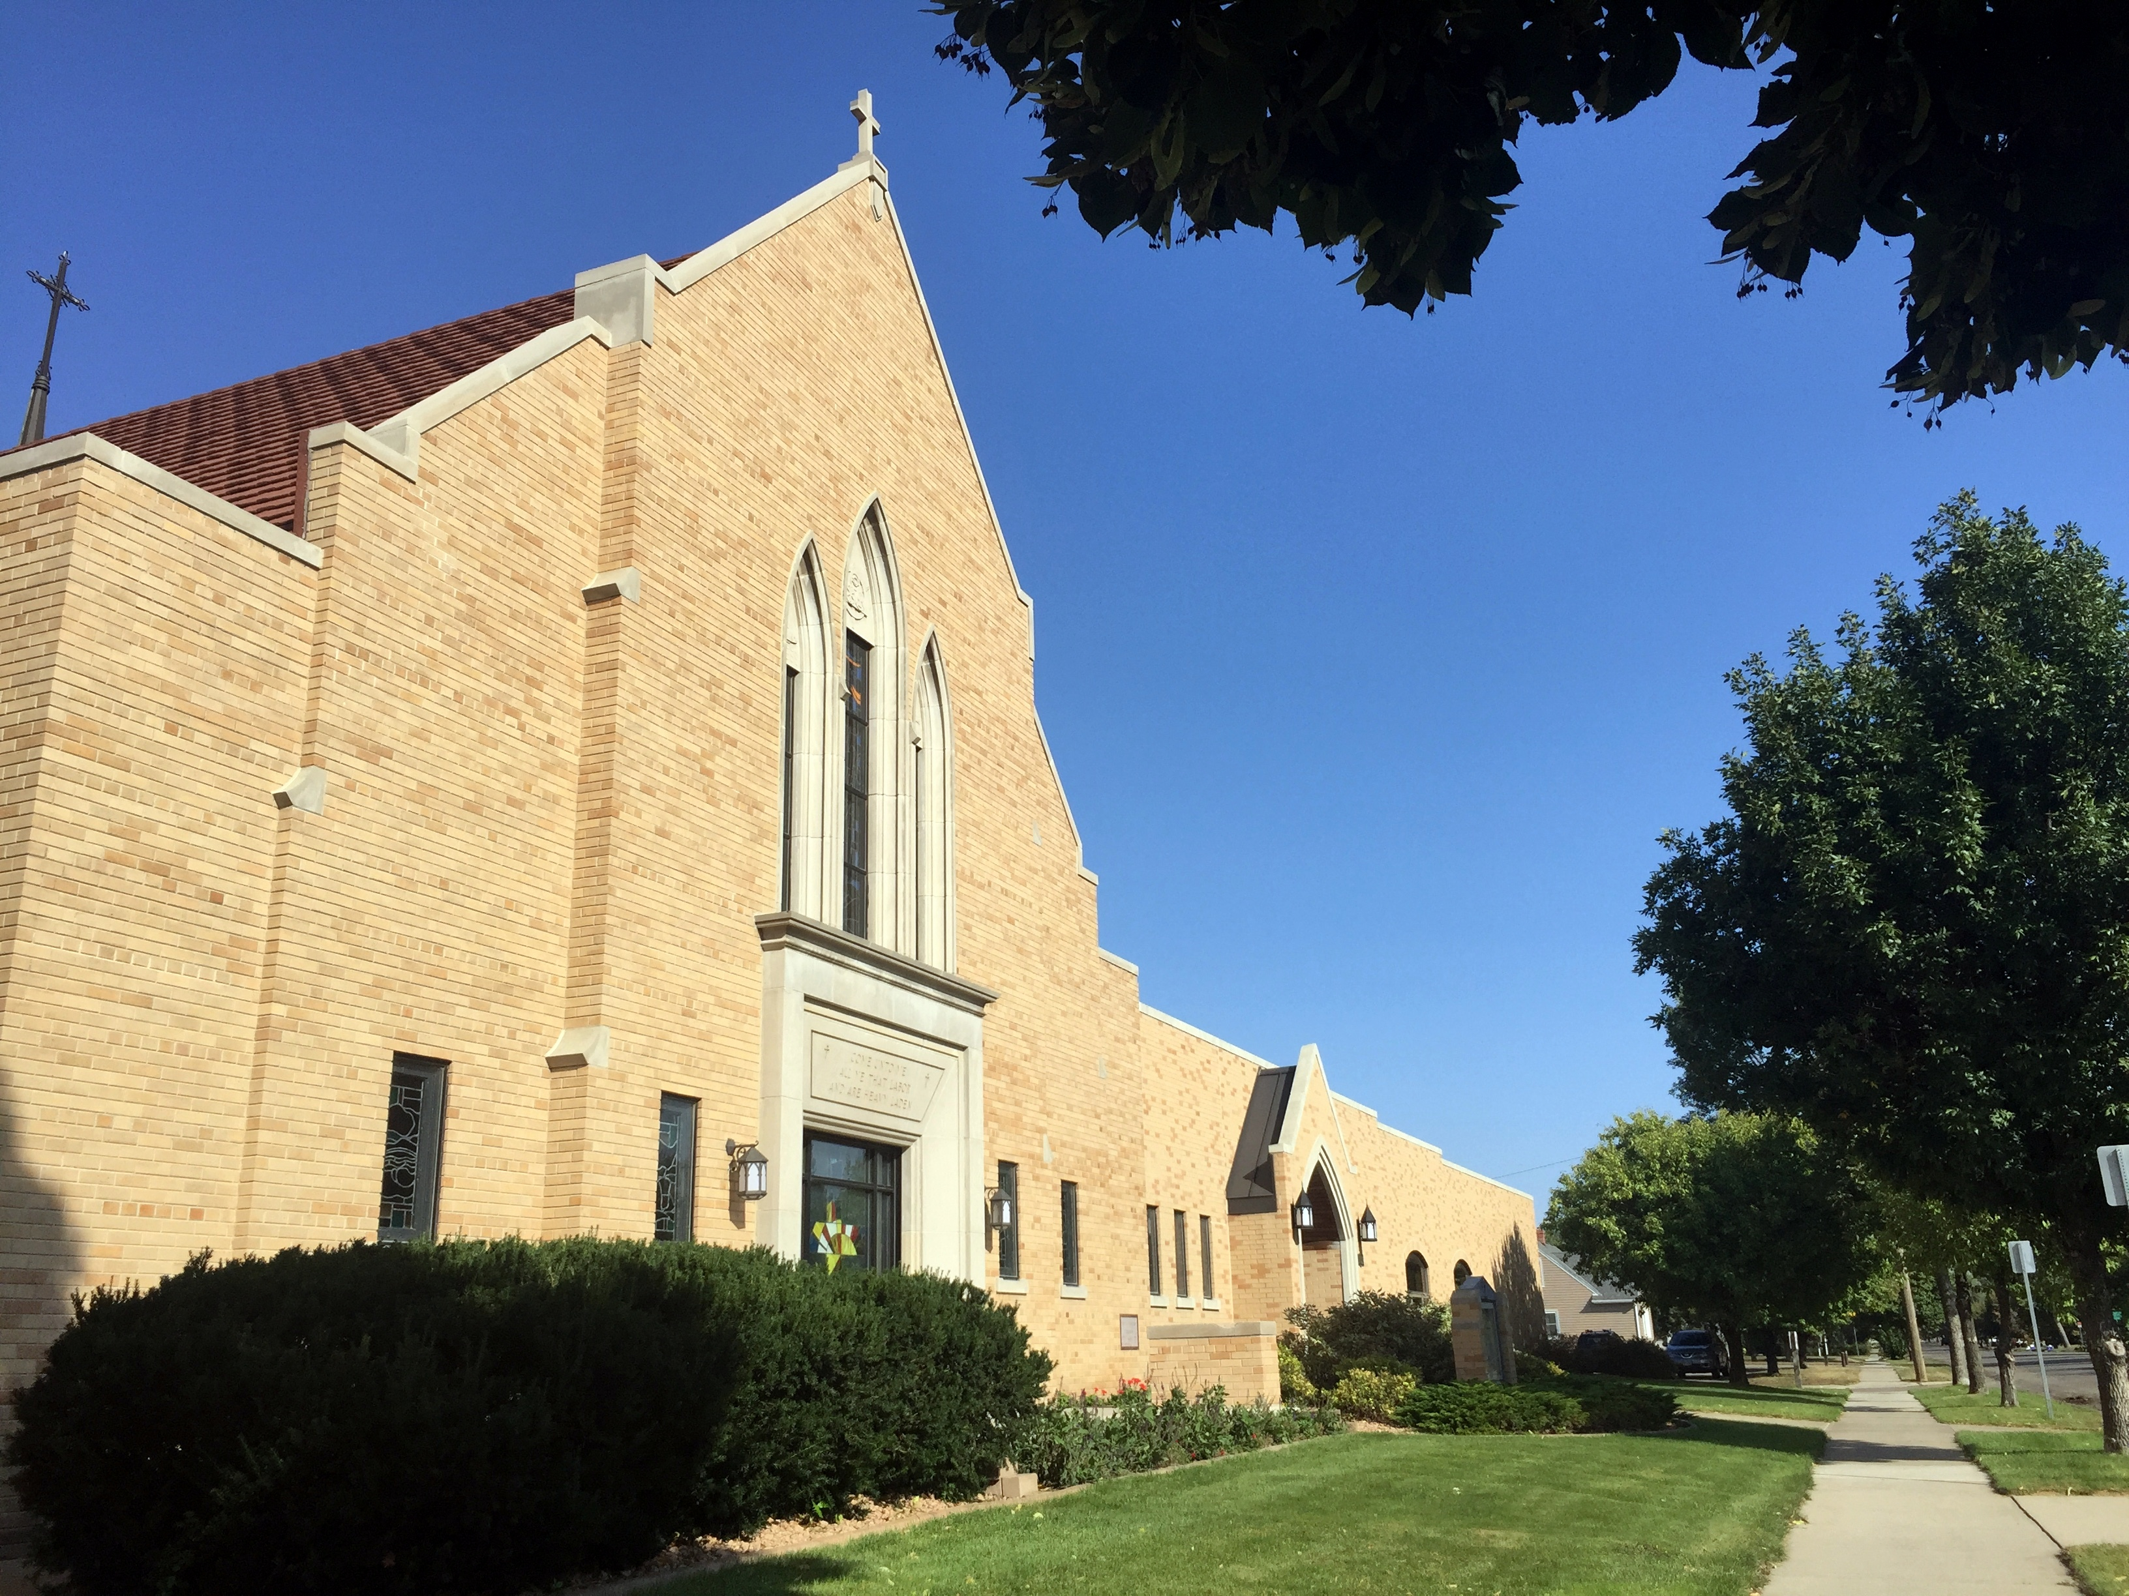
Welcome to
Zion Lutheran Church!
605-225-6755
zion@nvc.net
www.zionlutheranaberdeen.org

